Slide 1

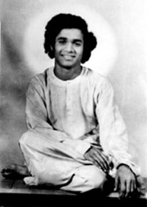
2.bALAGOPALA
~SATHYAM SIVAM SUNDARAM
OM SRI SAI RAM OFFERING OUR HUMBLE PRANAMS AT THY LOTUS FEET OF OUR BELOVED MOTHER SAI.

Slide 2

botHe is Shiva , he is Shakti ; he must have h Vibhuti and Kumkum.
~ Many mysterious things were being happening in Pedda Venkama Raju’s house. This was the time when the divine birth was about to occur.

Slide 3
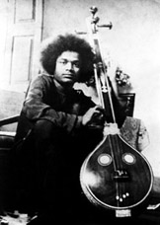
Mystical happenings took place –
The brothers and the father were all very much interested in the village operas on puranic incidents.
There was a tambura leaning against the wall , maddela or drum.
These two were silent only when the inmates of the retired from the house.
Tambura twanging automatically.
Maddala beating as if an expert’s hand was handling it.
Later these happenings were defined by a sastri that it meant the presence of SAKTHI, a beneficiant power , conferring harmony, melody ,order ,symmetry ,spiritual elevation and joy.

Slide 4
THE BIRTH
On 23rd of November, 1926, the divine birth took place.
The villagers were chanting the names of SIVA.
It was the holy day of KARTHIK SOMAVARA.
The year was AKSHAYA, the ‘never-declining, the ever-full! ’.
The mother had just finished her Sathyanarayana Pooja.
Grandmother gave the mother, the flower and sacred water.
Next moment, the Lord was born.
The sun rose above the ground.

Slide 5
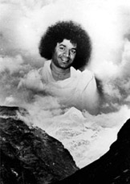
ABOUT THE INCARNATION
Baba has ones said that one special point to be noted about this manifestation is that the incarnation is not been transplanted away from the place where the body was born he has chosen that particular place as the centre of his alleviatory Mission.
Puttaparthi must have been doubly happy , for the avatar had chosen that village for his birth, as well as his habitation.

Slide 6
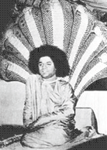
Sheshasai
A snake was there in the lying-in room!
The women didn’t notice it for a long; but , when the baby, laid on a bed of clothes , was being moved up and down in a peculiar way by something underneath , they watched with bated breath and when at last they searched , they found a cobra below the bed!
The snake was acting the role of SHESHA to the SHESHASHAYI.

Slide 7
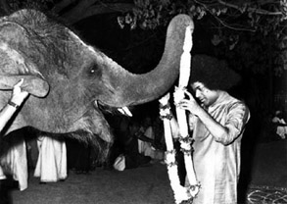
He kept away from where any animal were killed or tortured , or where fish was trapped or caught;
He avoided kitchens and vessels used for cooking flesh or fowl.
He was called by the neighbours , ”BRAHMAGNANI” on account on his type of aversion and this measure of love towards creation.
The boy used to run to the karman’s house , for they were brahmins and vegetarians, and take food offered by subbama,the aged lady residing there.

Slide 8
At this tender age of three and four ,”This braahmin” behaved as if he had a heart that melted at human sufferings.
Whenever a beggar appeared at the door and raised his cry, satya left his play and rushed in , to force his sisters to dole out the grain or food.
The adults naturally irritated by the endless procession and usually lost temper and shouted the beggar off, before satya could bring relief;
This made the child weep so long and that only by bringing the beggar back could the elders stop the wailing.
Sometimes mother used to caught hold the child and warned him that “look here! You may give him food; but , mind You ,you will have to starve.”
That didn’t daunt the child ; he used to run inside and bring out food to hungry man and he himself didn’t touch his lunch or dinner.

Slide 9
But the child has mysterious visitor who was feeding it !
For when he refused food and persisted in the refused for days , his behaviour showed no sign of starvation.
He would also declared that he had eaten and that Tata(an old man),had fed him sumptuously,doling balls of milk rice.the full stomack was prrof of that.

Slide 10
Who is mysterious person who fed swamy?

Slide 11
There is a primary school in the village of puttaparty and satya also used to go.
And there are punishments at that time on time concerns.
In order to escape these punishments students used to gathered eaves of the school house.
Satya helps them by giving towels , shirts etc…, to make them comfortable.

Slide 12
Questions
why and how tambura twanging automatically and beating itself ? And what did shastry said to pedda venkapa Raju?
On which auspicious day did swamy was born ? Which God people used to worship at that day ? {please mention month and year}
After searching the bed of clothes what came out in a peculiar way when the baby was slept and which role it was playing ?
On whose house CHILD used to eat food ? [VEGETARIAN].
Where was satya there at the midnight of sri rama Navami and what did the companions said ?

